Slide 1
Spring Boot

Slide 2
Module 1: Spring Boot Basics

Slide 3
Module 1 Design
2
Overview, App Creation, Code Walkthrough
Spring Basics, Spring Boot Benefits
Spring Boot Starters, Devtools
Target CRUD Rest APIs that can be tested with tools such as Postman
Writing POJO classes for business entities
Module 1
Spring Boot Basics
Use Case 1
A simple REST API for CRUD operations using POJOs
(no database)
Annotations, Rest Controllers, CRUD APIs
S/W Requirements
IDE : Spring Tool Suite 3
Testing tool: Postman
Cheat Sheet for Spring Boot

Slide 4
Module 1 Overview
Overview of Spring Framework and Spring Boot
Getting started with a Spring Boot app (Creation, Running) etc
Code walkthrough of a hello world app
Basics of Spring framework
Spring Modules Overview
Spring to Spring Boot Evolution – In Detail

Slide 5
Use case 1
As part of the use case 1, you have to build a simple CRUD based REST API for dealing with customers data
In this uses case 1, no database need to be used
We will only use in-memory data structures such as a arrays or list to store and manipulate data
Use/Define a customer model/entity as shown
There should be REST APIs built for
  Listing all customers
  Getting one customer details
  Creating a new customer
  Updating an existing customer
  Deleting an existing customer
Customer Model
id - number
firstName - string
lastName - string
email - string
phone - string
active - string
password – string
role - string

Slide 6
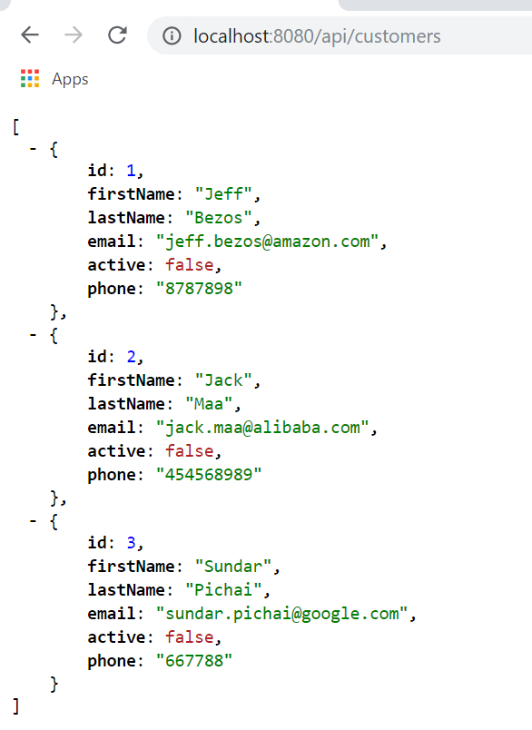
Use Case 1 – Output – GET All Customers
The REST API for /api/customers should return the output as shown in the left diagram
This demonstrates a typical HTTP GET operation on the url http://localhost:8080/api/customers
The response should be a JSON, that contains an array of customers

Slide 7
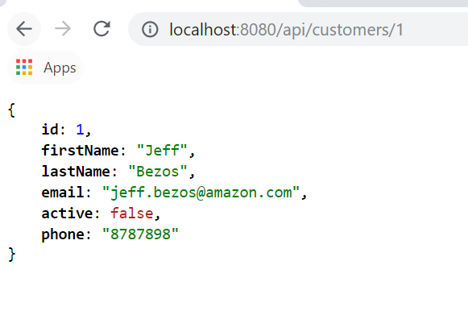
Use Case 1 – GET One Customer Details
The REST API for /api/customers/1 should return the output as shown in the left diagram
This demonstrates a typical HTTP GET operation on the url http://localhost:8080/api/customers/1
The response should be a JSON, that contains a single customer details

Slide 8
Use case 1 – Create, Update and Delete
The previous 2 diagrams explained only the read operations (GET all, GET one)
But the use case should also support the create, update and delete operation
There should be REST APIs available for each one of the following
  Create a new customer
  Update an existing customer
  Delete an existing customer
The below table explains the typical Create, Update and Delete operations involved in a REST API
Action | HTTP method | Target URL | Request Body
Create | POST | /api/customers | Customer data
Update | PUT | /api/customers/123 | Customer data
Delete | DELETE | /api/customers/123 | None

Slide 9
Module 1: Spring Boot Basics

Slide 10

What is Spring Boot
Spring Boot is an open-source framework that makes it easy to create stand-alone, production-grade Spring based applications
Spring Boot takes an opinionated view of the Spring platform and 3rd party libraries
Spring Boot is developed on top of the most successful Spring framework/ecosystem
It is developed by the team at a company named Pivotal
Spring Boot is used at big brands such as at big brands like Netflix, Alibaba etc. for developing backend services/microservices

Slide 11
Spring Boot – Background & Evolution
Spring Boot is the successor to Spring framework
Spring framework was one of the most successful enterprise application development framework
But Spring had lots of manual configurations and wirings up that needed to be done
So, Spring Boot was developed to simplify spring programming
Notes:
Courtesy: https://content-static.upwork.com/blog/uploads/sites/3/2015/05/05110037/Front-end-dev1.png

Slide 12
Creating a Spring Boot Project
There are 3 ways to get started with a spring boot project
  Through IDEs such as Spring Tool Suite 3 or Eclipse with plugins or IntelliJ Idea
  Through the web page https://start.spring.io/
  Through the command line utilities
The most common IDE used for creating spring boot app is STS (Spring Tool Suite)
In the coming slides, we will see how to create a spring boot project through various means

Slide 13
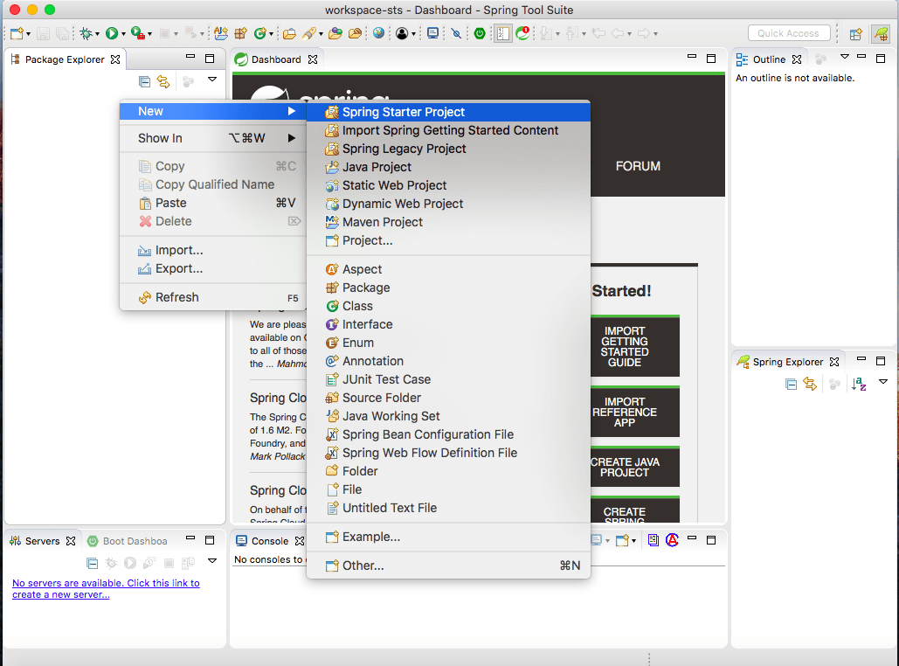
Spring Boot Project through STS
After STS is ready, right click on package explorer, then New -> Spring Starter Project
This can be invoked through File -> New -> Spring Starter Project also
Ref:- https://www.javacodegeeks.com/2018/07/spring-boot-project-sts.html

Slide 14
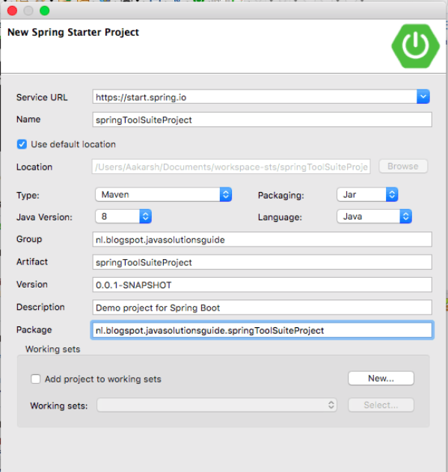
STS – Project details screen
Next, In the project details screen, enter details such as the project name, group id, artifact id and the package name
We can also specify other details such as Java version, build tool(maven or gradle), packaging
Ref:- https://www.javacodegeeks.com/2018/07/spring-boot-project-sts.html

Slide 15
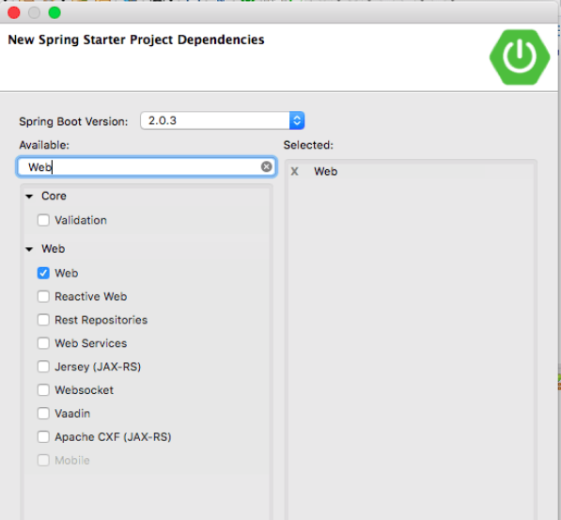
STS – Adding Project Dependencies
In the dependencies screen, we can choose all the dependencies that the project needs
We can choose dependencies such as web, jdbc, jpa etc
Ref:- https://www.javacodegeeks.com/2018/07/spring-boot-project-sts.html

Slide 16
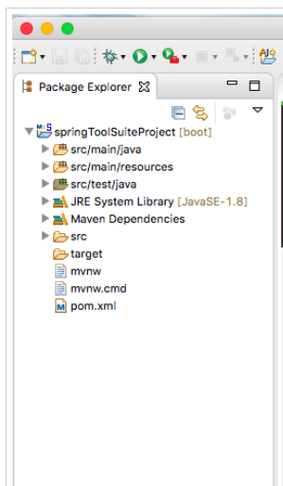
Spring Boot project structure
After the project creation is finished, we will get a project structure as shown in the left picture
This is a typical maven project structure which contains
  pom.xml – maven config file
  src – the source code of our project
Ref:- https://www.javacodegeeks.com/2018/07/spring-boot-project-sts.html

Slide 17
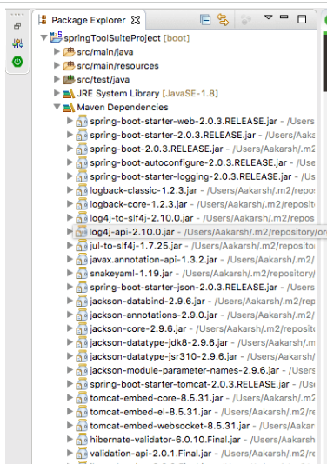
Maven dependencies Section
In the package/project explorer, when you expand the “Maven Dependencies” section, we can see all the jars that are downloaded for this project
Even in an empty spring boot project, lots of spring core jars and some specific to spring boot’s common functionalities will be downloaded
Ref:- https://www.javacodegeeks.com/2018/07/spring-boot-project-sts.html

Slide 18
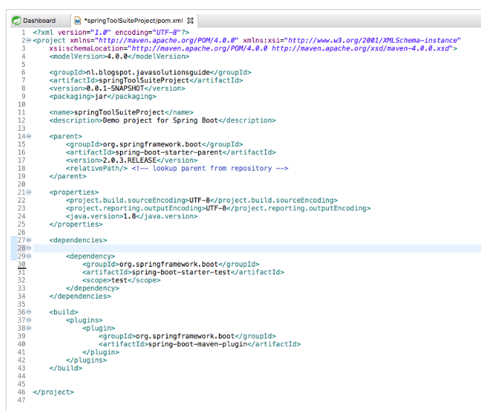
Spring Boot – Empty Project Pom.xml
In the left picture, we can see that the pom.xml for an empty spring boot project
We have not chosen any dependencies(web, jdbc etc) for this project
Ref:- https://www.javacodegeeks.com/2018/07/spring-boot-project-sts.html

Slide 19
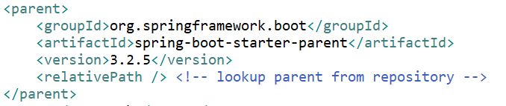
Pom.xml – parent section
If you observe the <parent> tag in the pom.xml of our spring boot project, we can see that its referring to spring-boot-starter-parent, as shown below
Any maven project can inherit properties from a parent project. In a spring boot project, we are inheriting from the parent starter project named spring-boot-starter-parent
The spring-boot-starter-parent project provides the core functionalities of a spring boot project

Slide 20
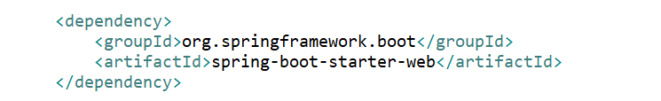
Spring Boot – Adding web dependency
The first project we created was a blank project which doesn’t enable web functionalities
To convert our spring boot project to a web backend API layer, we need to add the web dependencies in the pom.xml, as shown below
Once we add spring-boot-starter-web in pom.xml, all web dependencies, such as embedded tomcat, Jackson library for JSON processing, etc

Slide 21
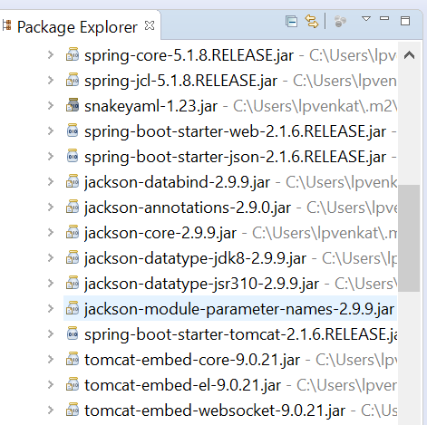
Spring Boot – Web related dependencies
As shown in the picture, once the spring-boot-starter-web is added to the pom.xml, lots of extra dependencies are downloaded
They are
  Embedded tomcat
  Jackson Java parsing library

Slide 22
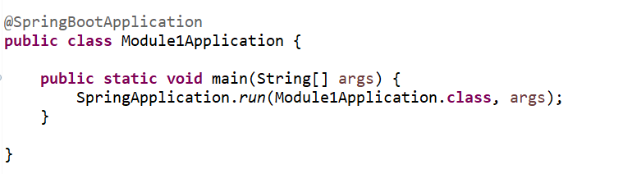
Spring Boot – The main file
We have created a blank spring boot project and added the web dependency to it
Spring Boot creates a main file, which looks like a standard java application, with a main method
The only difference here is that the main class is annotated with a @SpringBootApplication
From the main method of Module1Application, SpringApplication class’s run method is called
This run method ensures that the following steps are done
  Sets up default configuration
  Starts Spring application context
  Performs class path scan
  Starts tomcat server

Slide 23
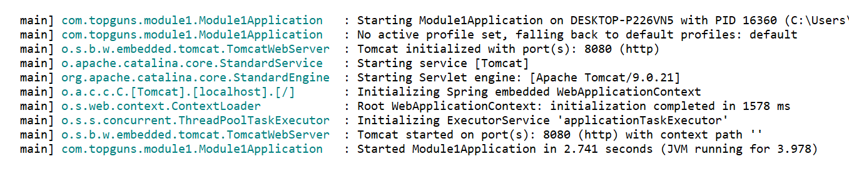
Running the spring boot app
When you right click the project and select Run as -> Spring Boot App, the web application should get deployed in the embedded tomcat server
The below diagram clearly demonstrates that the embedded tomcat server is running and hosting the spring boot app in the default port
The default port no is 8080 for a spring boot app
The port no is configurable and multiple spring boot apps can be run locally in various ports

Slide 24
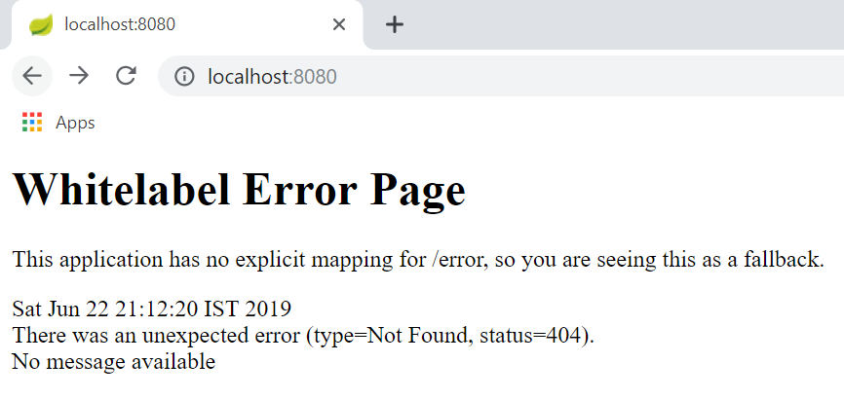
Spring Boot – Standard output
The default app, after it started running, when we reach the web application through the default URL, we should get the below output

Slide 25
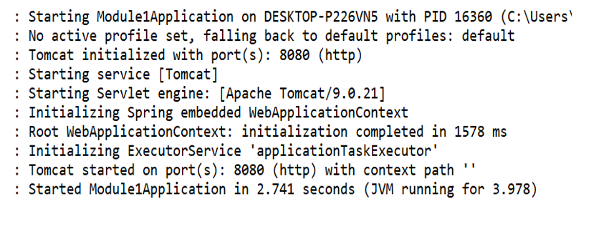
Embedded Servlet Containers
Traditionally, Spring applications have to be hosted on a web server such as Tomcat
Tomcat serves as the Servlet container for running spring based applications
So, there was a separate deployment step
But Spring Boot comes with an embedded Tomcat server, which provides
  Convenience of deployment
  Stand alone application
When we run the boot app, we can see that tomcat is running
Spring Boot Application
Embedded Tomcat Server
Embdded Tomcat running in port 8080

Slide 26
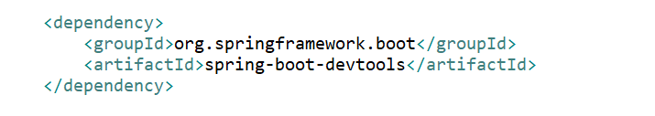
DevTools
During the development process, we have to restart the dev server every time the code changes
This leads to a slow iterative process of code, fix and debug cycle
Hence, the spring ecosystem introduced a new starter package called Devtools, (Spring Development Tools)
We need to include the Devtools starter package as a dependency in the pom.xml
After adding Devtools, if we start the local dev server, then onwards for any code file changes, the dev server will get restarted automatically

Slide 27
Spring Boot Starters
Bill of materials
Set of convenient dependency descriptors which we can include in our application
Makes development easier and rapid
For e.g. for using JPA for database access, include the spring-boot-starter-data-jpa starter
Most common starters for spring boot are provided under the org.springframework.boot group
org.springframework.boot
spring-boot-starter-web
spring-boot-starter-test
spring-boot-starter-jdbc
spring-boot-starter-actuator
Notes:
Courtesy: https://content-static.upwork.com/blog/uploads/sites/3/2015/05/05110037/Front-end-dev1.png

Slide 28
Important Starters
spring-boot-starter-web
  It is used for building web, including RESTful, applications using Spring MVC. Uses Tomcat as the default embedded container
spring-boot-starter-jdbc
  It is used for JDBC with the Tomcat JDBC connection pool
spring-boot-starter-actuator
  It provides production ready features to help you monitor and manage your application.
spring-boot-starter-test
  It is used to test Spring Boot applications with libraries including Junit and Mockito
spring-boot-starter-data-rest
  It is used for exposing Spring Data repositories over REST using Spring Data REST

Slide 29
Advantages of Spring framework
Spring enables developers to develop enterprise applications using POJOs (Plain Old Java Object)
Spring provides an abstraction layer on existing technologies like servlets, JDBC, ORMs, Logging etc to simplify the development process
Spring WEB framework has a well-designed web MVC framework
Spring framework has taken the best practice that have been proven over the years in several applications and formalized as design patterns
Spring gives built in middleware services like Connection pooling, Transaction management

Slide 30
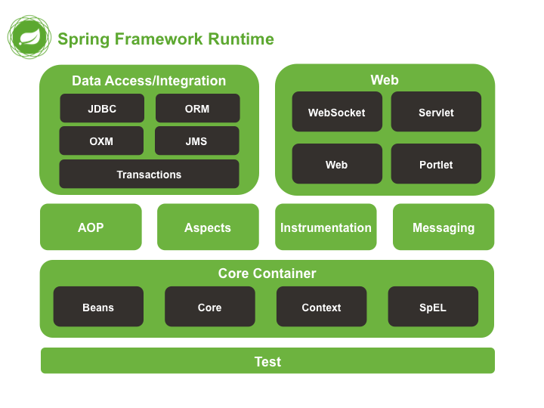
Spring Framework Modules
Spring framework consists of features organized into about 20 modules, these modules are grouped into Core Container, Data Access/Integration, Web, Test and many more
Important Modules
  Spring Core Container
  Spring JDBC and DAO Module
  ORM Module
  Web Module
Ref:- https://docs.spring.io/spring/docs/5.0.0.RC2/spring-framework-reference/overview.html

Slide 31
Spring Core Container
The Spring Core container is the basis for the complete spring framework
The Spring core container provides an implementation for IoC supporting Dependency Injection
Business POJOs
The Spring Container is responsible for managing the objects life cycle such as
  Creating the Objects
  Calling initialization methods
  Configuring objects by writing them together
Configuration Metadata
Spring IOC Container
Java Application (Ready For Use)

Slide 32
What is dependency injection?
Before understanding dependency injection, lets try to understand the term “dependency” in our software code
Presentation Layer
As shown, we have the following dependencies in software layer
  The presentation layer depends on the business layer
  The business layer depends on the data access layer
Dependency
Business Layer
Dependency
Data Layer
Database
Services

Slide 33
Dependency Injection – Loosely Coupled System
As seen in the slide earlier, the clients have to create and manage their dependencies
When each software layer manages their own dependencies, it becomes a tightly coupled system
Tightly coupled systems are very difficult to manage, fix errors, or test or even modify/upgrade
Hence the modern enterprises prefer loosely coupled systems
Dependency injection helps to build loosely coupled systems by delegating the job of managing the dependencies to a common module named injector
The injector takes care of creating and maintaining the dependencies
Hence the name Dependency injection
There are so many dependency injection frameworks, but the most popular in the Java world is Spring framework
DI is one of the functionalities of Spring framework apart from so many other features

Slide 34
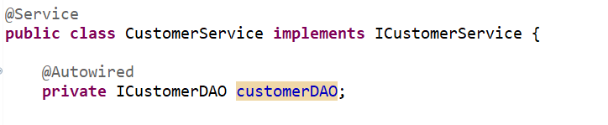
A Sample dependency injection
The below piece of code shows that the CustomerService class is dependent on CustomerDAO class.
Instead of creating and managing the customerDAO object by itself, the customer service class delegates that dependency management to the DI framework (Spring framework)
Hence, the service class needs to worry only about business services rather than the pain of creating and managing the object lifecycle of its dependency(DAO class)
More on Spring Boot Annotations later
DAO object will be injected by Spring framework

Slide 35
Spring Problems/Disadvantages
Spring is a huge framework which has so many moving parts
Multiple setup steps
Multiple configuration steps
Multiple build and deploy steps

Slide 36
Spring Boot – But Why?
Spring Boot is not a whole new framework from scratch
Spring Boot is just an abstraction layer top of Spring
Spring Boot is opinionated
We are no throwing away Spring, rather we are just building on Spring
Basically, Spring Boot is built with the following things in mind
  Very less configuration
  Convention based framework
  JAR incompatibilities are taken care of by using starters
  Simplifies overall development experience
  Less plumbing/configuration code, but more business logic code

Slide 37
Spring Boot Benefits
Spring Boot takes a convention based approach and hence manual configurations are not needed
It uses an annotation based approach which is more friendlier than the clumsy XML configurations
Embed Tomcat, Jetty or Undertow directly (no need to deploy WAR files)
Hence, It allows to create stand-alone Spring applications
It simplifies dependency management of our application
Increases productivity and reduces the development time
Provide opinionated 'starter' dependencies to simplify your build configuration
Automatically configure Spring and 3rd party libraries whenever possible
Provide production-ready features such as metrics, health checks and externalized configuration

Slide 38
API first approach – Spring Boot
The modern enterprise application development takes an API first approach
The APIs could be consumed by a browser app or a mobile app or a TV app or a smart watch app
Gone are the days, where in we had only desktop apps or console only apps
In a full stack development, the server side is taken care by Spring Boot REST APIs
In case of web apps, the front end could be a SPA framework like React

Slide 39
MVC Architecture
MVC architecture is the most common architecture used in modern web applications
MVC stands for Model, View and Controller
MVC provides ‘separation of concern’ concept, where each part has its own responsibility
A typical MVC architecture is shown in the below diagram
Client(Browser)
MVC App
Controller
Model
View

Slide 40
MVC - An explanation
Models
  This layer typically represents the tight bonding with the databases (relational or other form of databases)
  This layer might handle validations and association between models
View
  Presents data in a particular format, triggered by a controller’s decision
  This presentation can be of various format types such as HTML, JSON, XML or even PDFs etc
  The final result of the view is nothing but the user interface (UI), that the user sees
Controllers
  This layer is the orchestration layer that controls the flow between the client, the models and view
  Controllers receive the request from the client, decides which model data should be used, and then decides which view should be used to render the data to the client
  Controllers can also do some cleanup of data received from the client

Slide 41
MVC – More detailed diagram
A more detailed flow of the MVC architecture
Spring Boot (embedded tomcat)
Brower/Client
Web Server
Routing
Controllers
View
Models

Slide 42
Spring Boot Annotations
As already discussed, Spring Boot does not use XML Configuration anymore and implements the convention over configuration principle
Spring Boot uses what are called Annotations to adopt conventions based approach
Annotation is a form of metadata which provides data about a program
Annotations can be applied on a class, method, or a parameter etc
Based on the context of where it is applied, annotations can have different side effects on the program

Slide 43
Spring Boot - Annotations
There are some commonly used Spring Boot Annotations
  @SpringBootApplication – enables auto configuration and component scanning
  @Autowired – makes a field to be auto wired by Spring dependency injection
  Controller related annotations
  @Controller – makes the class as a web controller, capable of handling http requests
  @RestController – makes it capable of handling REST requests (returning JSON or XML)
  @RequestMapping - maps HTTP request with a path to a controller method
  Database and Services related annotations
  @Repository – indicates the class as a repository class, which is an abstraction of
  @Service – to mark a class as a service class
  We will see some of these annotations in details as we progress

Slide 44
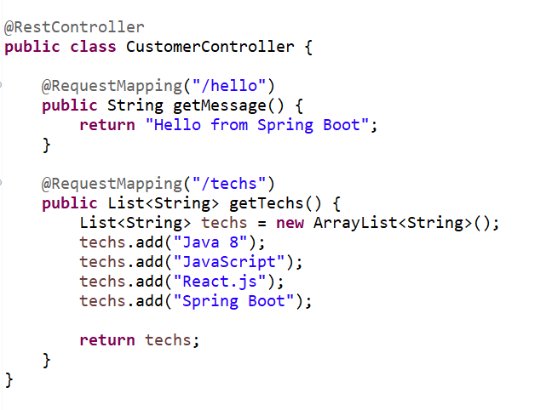
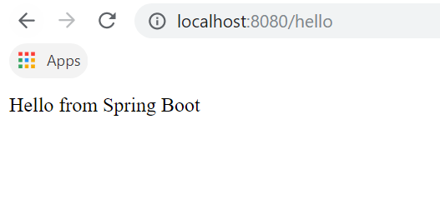
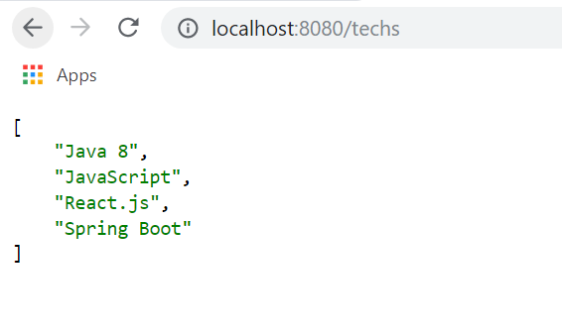
REST Controller
We are using Spring Boot as a pure REST API layer
Lets start writing a simple REST controller as below

Slide 45
Controller Annotations explained
In the previous slide, we wrote 2 simple APIs, one returning a simple string and other returning an array of strings
We will also build a full fledged REST apis, where we could return objects and list of objects
We use @RestController annotations for converting a class to a rest controller
@RestController combines the job of @Controller and @ResponseBody
When we use @RestController on any class, every request handling method of that controller class automatically serializes return objects into HttpResponse
This simplifies rest programming, as we don’t have to manually convert java objects into JSON response
Objects to JSON conversion is internally taken care by the appropriate annotations

Slide 46
Swagger Integration

Slide 47
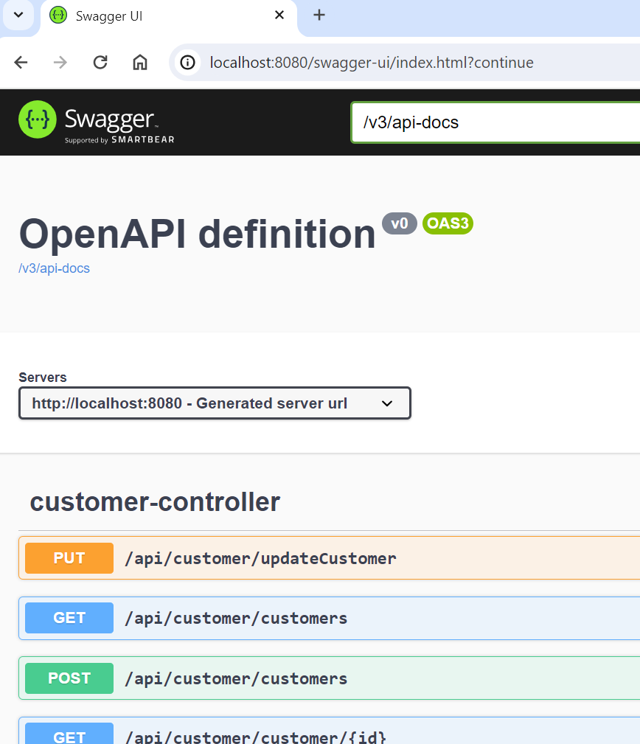
Swagger Integration
Swagger UI is used to visualize and interact with the API's resources without having any of the implementation logic in place.
Adding the Maven Dependency
  <dependency>
  <groupId>org.springdoc</groupId>
  <artifactId>springdoc-openapi-starter-webmvc-ui</artifactId>
  <version>2.1.0</version>
  </dependency>

Slide 48
Let us implement of use case

Slide 49
Use case 1
As part of the use case 1, you have to build a simple CRUD based REST API for dealing with customers data
In this uses case 1, no database need to be used
We will only use in-memory data structures such as a arrays or list to store and manipulate data
Use/Define a customer model/entity as shown
There should be REST APIs built for
  Listing all customers
  Getting one customer details
  Creating a new customer
  Updating an existing customer
  Deleting an existing customer
Customer Model
id - number
firstName - string
lastName - string
email - string
phone - string
active - string
password – string
role - string

Slide 50
A full CRUD API
Earlier, we just saw a simple REST APIs, returning a string and an array of strings
But lets get closer to the real world scenarios of building a CRUD APIs
As we already know, CRUD stands for Create, Read, Update and Delete
In this module, we will use in memory arrays or lists only to store and manipulate data
In this scenario, we are just going to have 2 layers
  Service Layer (CustomerService)
  Controller layer (CustomerController)
CustomerController
getCustomers()
getCustomerByID(id)
createCustomer(cust)
updateCustomer(cust, id)
deleteCustomer(id)
maintains customer data in array or list
CustomerService

Slide 51
Writing a simple REST Controller
There are lots of annotations associated with writing rest controllers or controllers in general
  @Controller
  @ResponseBody
  @RestController
  @RequestMapping
  @PathVariable
  @GetMapping
  @PostMapping
  @PutMapping

Slide 52
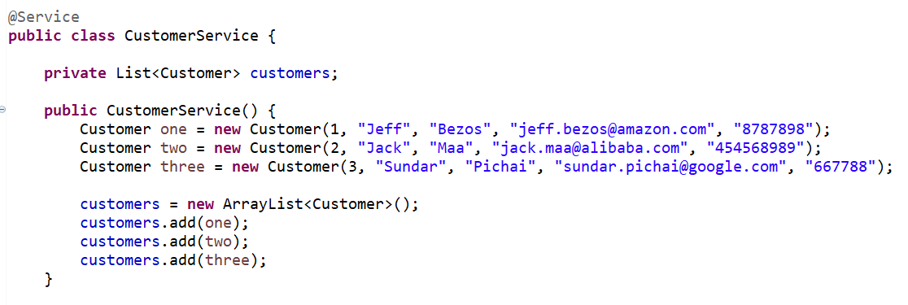
Implementing Customer Service
Lets create a simple customer service class using the @Service annotation
Spring @Service annotation is used with classes that provide some business functionalities
Spring context will autodetect these classes, so that they can injected in controllers
A simple CustomerService class, annotated with @Service annotation is shown below
It creates an array list to store and manipulate the customers data for CRUD operations

Slide 53
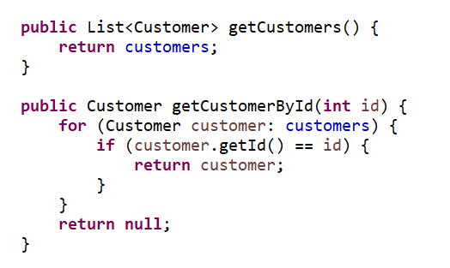
CustomerService CRUD methods
The standard read operations are shown below
  getCustomers() – return the entire list of customers
  getCustomerByID() – returns a single customer with the id

Slide 54
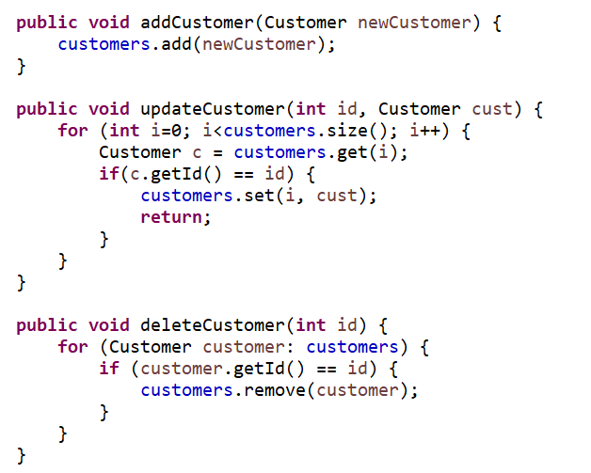
Create, Update and Delete (CUD operation)
The standard create, update and delete operations are shown below
No database operations, only in memory array list is used for storing and manipulation
Array list add method
Array list set method
Array list remove method

Slide 55
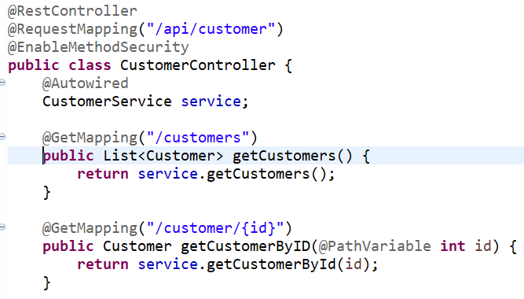
The Controller – Get operation
Lets write a simple CustomerController class, annotated with @RestController
Also, we can inject the CustomerService dependency using @Autowired annotation
@RequestMapping, @GetMapping, @PostMapping, @PutMapping and @DeleteMapping annotations are used for mapping the URL, the Http method and the actual class method that would be invoked for that HTTP operation

Slide 56
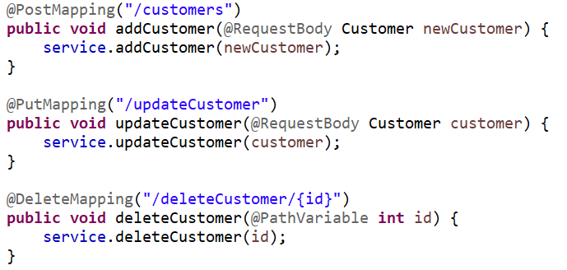
Controller – Post, Put and Delete operations
The remaining controller methods for POST, PUT and DELETE are shown below

Slide 57
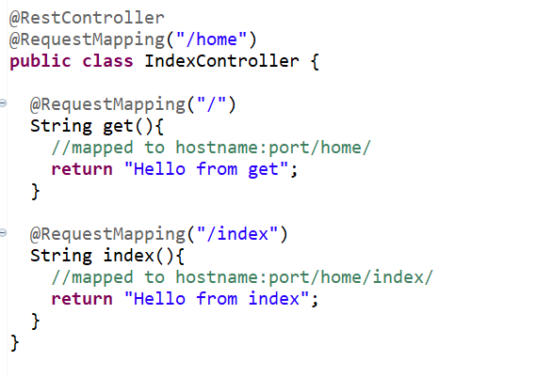
RequestMapping Annotation
Is used to configure the mapping between the requests and the handler methods
It can be applied to class-level and/or method-level in a controller
When applied at the class level, it becomes a common configuration for all the controller methods
Requests to /home will be handled by get() while request to /home/index will be handled by index()

Slide 58
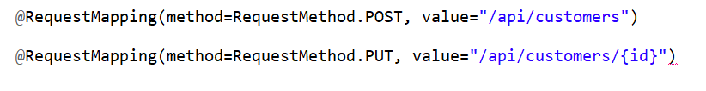
RequestMapping continued
It is capable of handling all HTTP methods, such as GET, PUT, POST, DELETE, and PATCH
By default all requests are assumed to be of HTTP GET type
In order to define a request mapping with a specific HTTP method, you need to declare the HTTP method and the actual URL value also
Notice the above examples, where method refers to the HTTP method, and the value refers to the URL mapping

Slide 59
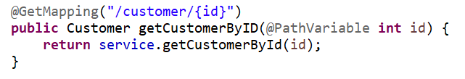
Dynamic URL handling - @PathVariable
The REST URLs will be sometimes static URLs but most of the real world scenarios handle with dynamic URLs
We already saw how to deal with static URL strings, but lets see how we can handle dynamic URL
The above handler could receive dynamic value for the id (Customer ID value)
To capture the dynamic url parameter, we can use the @PathVariable annotation
Dynamic URL

Slide 60
REST API testing tools
The REST APIs that we build using Spring Boot can be consumed by any application
But during the development phase, we typically tools such as browser, postman or curl to test and work with the APIs
Browsers can only be used to test GET operations directly
For a full fledged REST API testing, one can use tools such Postman or curl

Slide 61
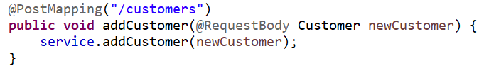
@RequestBody – Handling POST/PUT data
@RequestBody annotation maps the HttpRequest body to a transfer or domain object
It enables automatic deserialization of the inbound HttpRequest body onto a Java object
This annotation is typically used in POST or PUT or PATCH scenarios, where we get data in the body of the request during a create or an update operation

Slide 62
Exception Handling

Slide 63
Exception Handling
Creating Custom Exception
Throwing An Exception
Handling The Thrown Exception

Slide 64
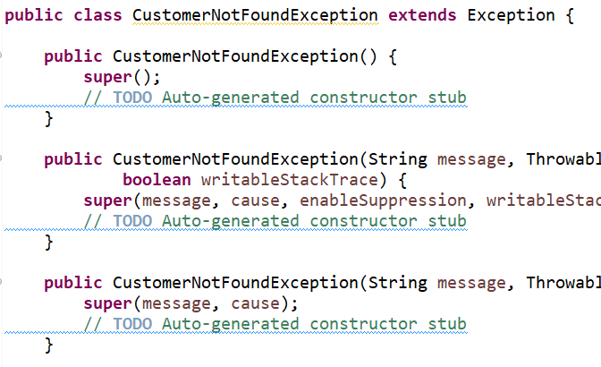
Creating Custom Exception
The custom exception class must inherit the RuntimeException class.
Inside the constructor, we need to call the super class constructor with an error message string.

Slide 65
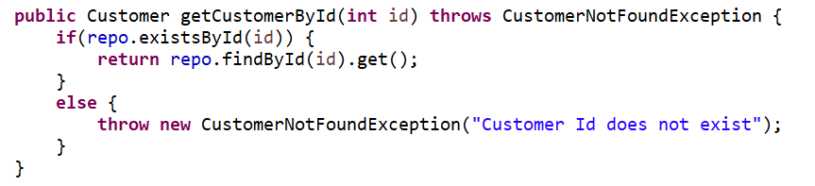
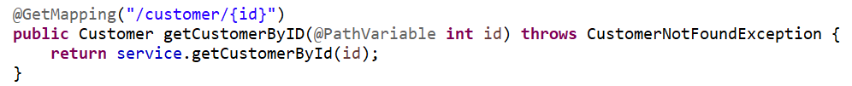
Throwing an Exception
Now we need to throw an exception whenever something bad happens in our controller.
CustomerService.java
CustomerController.java

Slide 66
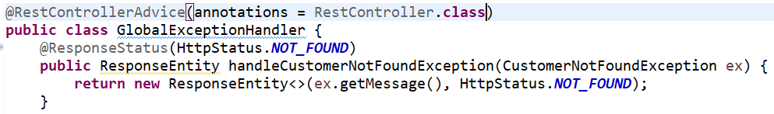
Handling the Exception
@RestControllerAdvice
      This annotation tells Spring that the class is designed to provide centralized exception handling for RESTful controllers.
@ExceptionHandler(CustomerNotFoundException.class):
      This annotation is used on a method to declare that it will handle exceptions of the specified type (CustomerNotFoundException in this case).
      When a CustomerNotFoundException occurs in any controller method, this method will be invoked to handle it.
@ResponseStatus(HttpStatus.NOT_FOUND):
      This annotation specifies the HTTP response status code to be set when the exception is handled.
      In this case, it’s set to 404 (NOT FOUND) because the exception is a CustomerNotFoundException.

Slide 67
Module 2 :Spring Data JPA

Slide 68
Module 2 Design
2
Layered Architecture for business apps
Db Access,
Postgres and connection properties
Implementation of DAO, Service and Controller layers
Target CRUD Rest APIs that can be tested with tools such as Postman
Enabling CORS
Module 2
Spring Data JPA
Use Case 2
Full CRUD based APIs with Postgres database
Logging, Actuators, Building the app
S/W Requirements
IDE : Spring Tool Suite 3 /IntelliJ
Testing tool: Postman
Cheat Sheet for Spring Boot

Slide 69
Module 2 Overview
Introduction to layered architecture of building enterprise apps/server backends
Introduction to database access in Spring Boot
Setting up Postgres connection, connection pooling etc
Writing a full fledged DAO(Data access layer) using JPA
Handling http responses in controllers using ResponseEntity objects
Introduction Cross Origin Request (CORS)
Enabling CORS globally or in controllers/methods
More on application.properties to configure various spring boot properties
Logging and Actuators

Slide 70
Use case 2
All of the operations should exactly work similar to Use case1
But, Customer data should be fetched from the postgres database compared to in-memory
2 tables should be created in the database (Customers and Accounts)
Accounts table should have a foreign key relationship with the Customers table through (customer_id) as the foreign key as demonstrated in the below diagram
Customer Model
id - number
firstName - string
lastName - string
email - string
phone - string
active - string
password – string
role - string
Accounts
id - number
account_type - number
account_number - string
account_branch - string
account_balance - numeric
customer_id - number
1:N

Slide 71
Use case 2 explained
The system should have 2 entities named Customers and Accounts
There should be an one to many association between customers and accounts i.e a customer can have multiple accounts
Apart from all the REST apis that are supported in the use case 1, there should be a separate API for accounts as well as shown below
Basically the REST client should be able to consume the customer based apis as well as the accounts based apis
A customer can have multiple accounts and hence the backend should provide an api to retrieve all the accounts of a particular customer
This is demonstrated in the next slide through a diagram

Slide 72
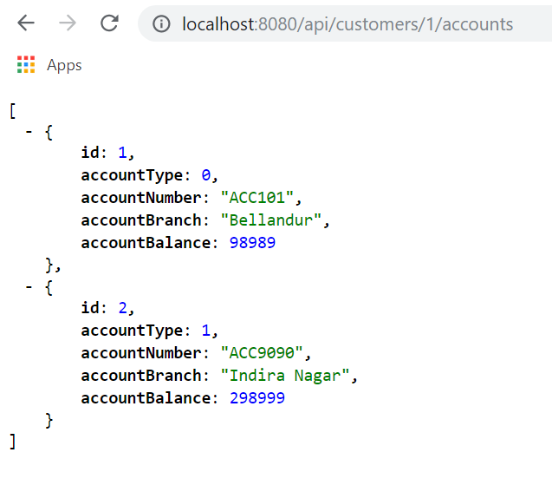
Use case 2 – Accounts REST API
GET /api/customers/1/accounts – should fetch the list of accounts of the customer with id 1

Slide 73
Layered Architecture

Slide 74
Layered Architecture
The modern enterprise applications are layered in a 2-tier or a 3-tire architecture based on the complexity of the application
The most common is the 3-tier architecture as shown below
As seen, the most common layers are
  Web layer
  Service layer
  DAO or Repository layer
Web Layer (controllers, exception handlers, views etc)
Service Layer (models the business services)
Repository or Data Access layer
Db related stuffs

Slide 75
Layered Architecture
Web Layer
  It is the uppermost layer of a web application
  responsible of processing user’s input and returning the correct response back to the user
  The web layer must also handle the exceptions thrown by the other layers
  it must take care of authentication and act as a first line of defense against unauthorized users
Service Layer
  It is the plumbing between the UI and the backend systems
  It is in charge of managing the business rules of transforming and translating data between the two layers (Web and DAL)
DAL(Data access layer) or Repository Layer
  It is the lowermost layer of a web application
  It is responsible for communicating with the data storage, filesystems etc

Slide 76
Adding a DAL (Data access Layer)
In the first module, we created POJO classes and also created simple service class
The service class was responsible for creating in-memory objects
But in real world apps, the actual data should come from the database
The Data access layer or the repository layer takes care of interacting with the database and returning that data to the service layer
We are going to use JDBC method of connecting to the database

Slide 77
ORM and JPA

Slide 78
What is ORM?
Object-Relational Mapping (ORM) is the process of converting Java objects to database tables. In other words, this allows us to interact with a relational database without any SQL.
RDBMS
Java Entity
ORM Tool
Convert Entity to SQL
Convert SQL Result Set to Java Entity

Slide 79
What is JPA?
JPA stands for Java Persistent API. It is an official specification from Java
That dictates the APIs to be used to persist Entities (Java Objects) in the database.
This specification is implemented by many ORM Tools
There are several ORM tools that implement their own API.
This becomes a portability problem if you want to switch between them for any reason.
This is where JPA helps you by providing an API layer on top of ORM tools.

Slide 80
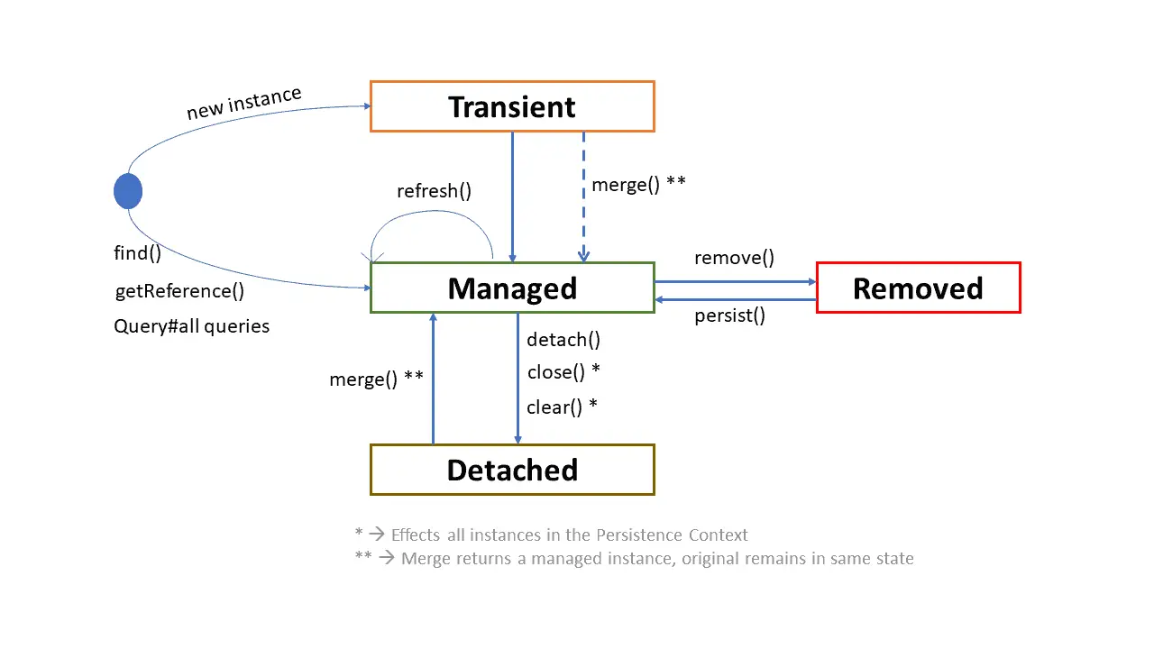
JPA- Entity Life Cycle Management

Slide 81
JPA- Entity Life Cycle Management
Transient State :
  When an entity object is initially created, it’s state is New or Transient. In this state, the object is not yet associated with an EntityManager and has no representation in the database.
Persistent/Managed State :
  An entity object becomes Managed or Persistent when it is persisted to the database via an EntityManager’s persist() method, which must be invoked within an active transaction.
  If we are changing persistent State object values those are synchronized automatically with the database while committing the transaction.

Slide 82
JPA- Entity Life Cycle Management
Detached State :
  The state, Detached, represents entity objects that have been disconnected from the EntityManager.
Removed State :
  A persistent state entity object can also be marked for deletion, by using the EntityManger’s remove() with in an active transaction.
  Then entity object changes its state from Managed to Removed, and physically deleted from the database during commit.

Slide 83
What is Persistence Context?
The persistence context is the collection of all persistent (managed) objects of an EntityManager.
If we try to retrieve an entity, if the entity is existed in persistence context, then managed entity object returned from persistence context without accessing the database.
The main role of the persistence context is to make sure that a database entity object is represented by no more than one in-memory entity object within the same EntityManager.
Every EntityManager manages it’s own persistence context.
Persistence context act as a local cache for a given EntityManager.

Slide 84
Spring Data JPA

Slide 85
What is Spring Data JPA?
Spring Data JPA focuses on using JPA to store and manage data in a relational database.
To perform simple operation needs to write too much boilerplate code to execute simple queries.
Spring Data JPA aims to significantly improve the implementation of data access layers by reducing the effort to the amount that’s needed.
As a developer you write your repository interfaces, including custom finder methods, and Spring will provide the implementation automatically.

Slide 86
Spring Data JPA
Java Program
Spring Data JPA
Spring Data JPA
Hibernate,EclipseLink,MyBatis
Hibernate,EclipseLink,MyBatis
JPA(Java Persistence API)
JPA(Java Persistence API)
JDBC
JDBC
RDBMS
RDBMS

Slide 87
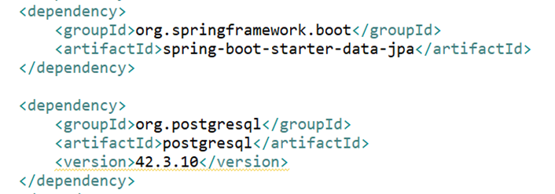
JPA Dependency using Maven
spring-boot-starter-data-jpa spring boot starters
We can use the either of the following maven dependencies

Slide 88
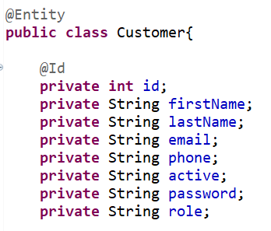
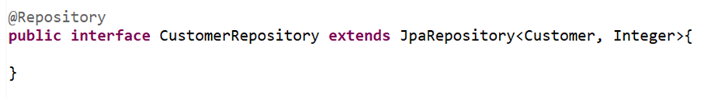
Entity of Customer and Repository
The Customer class is annotated with @Entity, indicating that it is a JPA entity..
The Customer object’s id property is annotated with @Id so that JPA recognizes it as the object’s ID/primary key
Customer Repository

Slide 89
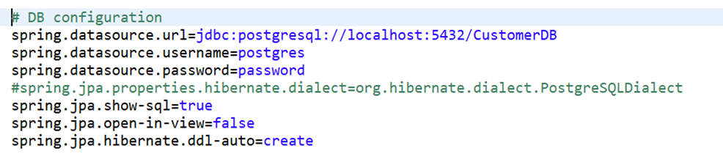
Datasource and connection properties
DataSource and Connection Pool are configured in application.properties file using prefix spring.datasource
In our scenario, where we have to use postgres, the following settings can be added in application.properties file
The application.properties is typically located in the resources subfolder inside the app folder
Spring Boot uses tomcat connection pooling by default for performance and concurrency

Slide 90
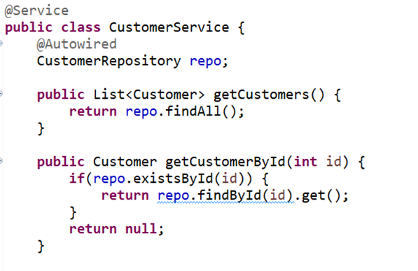
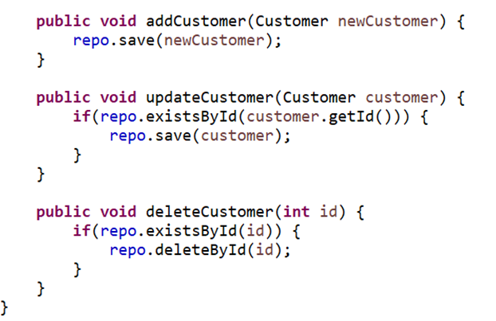
CustomerService

Slide 91
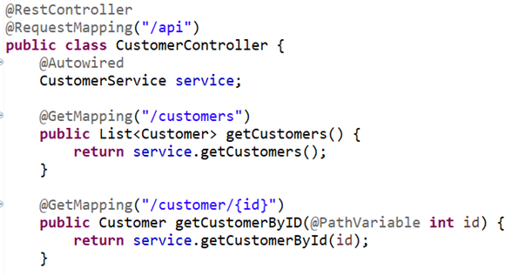
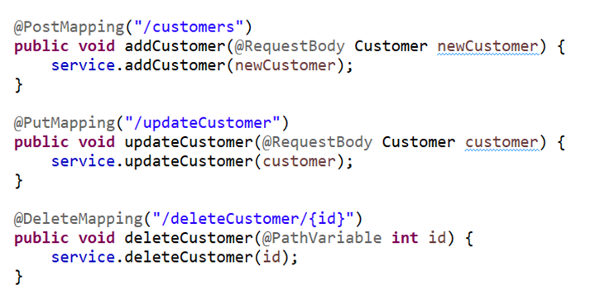
Controller for @RequestMapping
We can autowire in the classes annotated with spring stereotypes such as @Component, @Service, @Repository and @Controller

Slide 92
Annotations
@Entity - This annotation defines that a class can be mapped to a table.
@Table(name = "STUDENT") -The name of the database table to be used for mapping.
@Id - This annotation specifies the primary key of the entity.
@GeneratedValue- This annotation is used to specify the primary key generation strategy to use.
@Column(name = "id") – adding name of the column in the database.
@Embedded - used to embed a type into another entity.
@Embeddable - to declare that a class will be embedded by other entities.
@Transient - By using @Transient we can exclude the specific field or method from being persisted in our database.

Slide 93
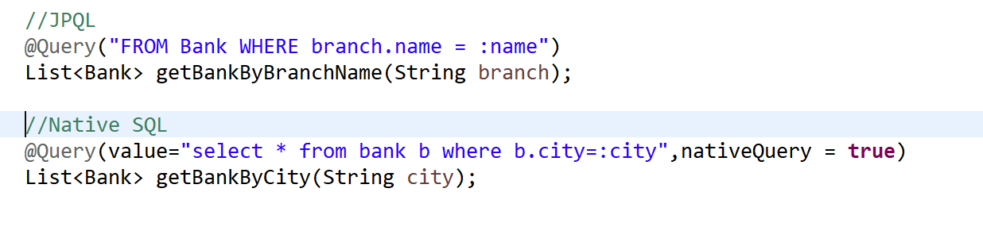
Custom Query
Spring Data provides many ways to define a query that we can execute. One of these is the @Query annotation.
In spring data JPA @Query annotation will help us to to execute both
  JPQL
  Native Query.

Slide 94
JPQL(Java Persistence Query language)
JPQL is an object-oriented query language which is used to perform database operations on persistence entities.
Instead of database table, JPQL uses entity object model to operate the SQL queries.
Benefits of using JPQL
  JPQL is portable across implementer and database
  No manual conversion of row data into Object and vice-versa
  Queries can be stored in cache to provide better performance

Slide 95
Association Mapping

Slide 96
Association Mapping
Association mapping represents relationship between entities.
A java class can contain an object of another class or a set of another class.
There is no directionality involved in relational world, Its just a matter of writing a query. But there is notion of directionality which is possible in java.
Hence association are classified as
  Unidirectional
  Bidirectional

Slide 97
Association Mapping
Employee – Passport | One To One | One Employee can have one passport
Bank – Branch | One To Many | One Bank can have multiple branch
Branch – Bank | Many To One | Many Branches belongs to One Bank
Account – Customer | Many To Many | One Account belongs to many customer and one customer can have one many account

Slide 98
One To One
@Entity
public class Customer {
@Id
private long customerId;
private String name;
@OneToOne(cascade=CascadeType.ALL)
@JoinColumn(name = "addressId")
private Address address;
}
@Entity
public class Address {
@Id
private long addressId;
private String street;
private String city;
private String state;
private String country;
}

Slide 99
Bidirectional Mapping – One To One
@Entity
public class Customer {
@Id
private long customerId;
private String name;
@OneToOne(mappedBy = "customer")
private Address address;
}
@Entity
public class Address {
@Id
private long addressId;
private String street;
private String city;
private String state;
private String country;
@OneToOne(cascade = CascadeType.ALL)
@JoinColumn(name = "customer_id")
private Customer customer;
}

Slide 100
One-To-Many
@Entity
public class Bank {
@Id
private String code;
private String name;
@OneToMany(mappedBy = "bank")
private Set<Branch> branch;
}
@Entity
public class Branch {
@Id
private long branchCode;
private String name;
private String address;
}

Slide 101
Many-To One
@Entity
public class Bank {
@Id
private String code;
private String name;
}
@Entity
public class Branch {
@Id
private long branchCode;
private String name;
private String address;
@ManyToOne
@JoinColumn(name = "bank_code")
private Bank bank;
}

Slide 102
What Is Cascading?
When we perform some action on the target entity, the same action will also be applied to the associated entity.
Cascade Type :
  PERSIST - propagates the Persist operation from a parent to the following child entity.
  MERGE - propagates the merge operation from a parent to the following child entity.
  REMOVE - propagates the removal operation from parent to following child entity.
  REFRESH - the child entity also gets reloaded from the database whenever the parent entity is also being refreshed.
  DETACH - - the child entity will eventually get removed from the persistent context.
  ALL - propagate all the operations - from a parent to a child entity.

Slide 103
Let us implement use case

Slide 104
Use case 2
All of the operations should exactly work similar to Use case 1 (slides 4 to 7)
But, Customer data should be fetched from the postgres database compared to in-memory
2 tables should be created in the database (Customers and Accounts)
Accounts table should have a foreign key relationship with the Customers table through (customer_id) as the foreign key as demonstrated in the below diagram
Customer Model
id - number
firstName - string
lastName - string
email - string
phone - string
active - string
password – string
role - string
Accounts
id - number
account_type - number
account_number - string
account_branch - string
account_balance - numeric
customer_id - number
1:N

Slide 105
Pagination and Transaction

Slide 106
Pagination and Sorting
Pagination is the process of displaying the data on multiple pages rather than showing them on a single page.
Also, we often need to sort that data by some criteria while paging.
You usually do pagination when there is a database with numerous records. Dividing those records increases the readability of the data.
It can retrieve this data as per the user’s requests.

Slide 107
Transaction
A transaction is a unit of work. We generally group the related work within one transaction so that if part of the work is failed then entire transaction should be failed. A transaction can be described by ACID properties (Atomicity, Consistency, Isolation and Durability).
  Atomicity : The entire transaction takes place at once or doesn’t happen at all.
  Consistency: The database must be consistent before and after the transaction.
  Isolation: Multiple Transaction occur independently without interference.
  Durability: The changes of successful transaction occurs even if the system failure occur.
  @Transactional annotation provides an easy way to declare your transaction handling in Spring.

Slide 108
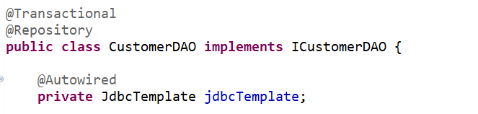
Transaction Management
@Transactional annotation is used for managing transactions in jdbc queries
It can be applied in class level or method level where in we run the JdbcTemplate queries
In this we have attached @Transactional annotation with the entire CustomerDAO class, which deals with the CRUD operations
Hence every jdbc query in the methods will be carried over as transactions

